Slide 1
Starting School
Starting school is a big step for you and your child…
….we want to work with you to make this transition a positive experience.

Slide 2
Each Child as an Individual
We feel it is important to ensure children:
Are allowed to develop at their own pace.
Have opportunities to build on their interests and be involved in topic plans.
Have the chance for uninterrupted play.
Are listened to and know what they have to say will be valued.
Are encouraged to be independent learners.

Slide 3
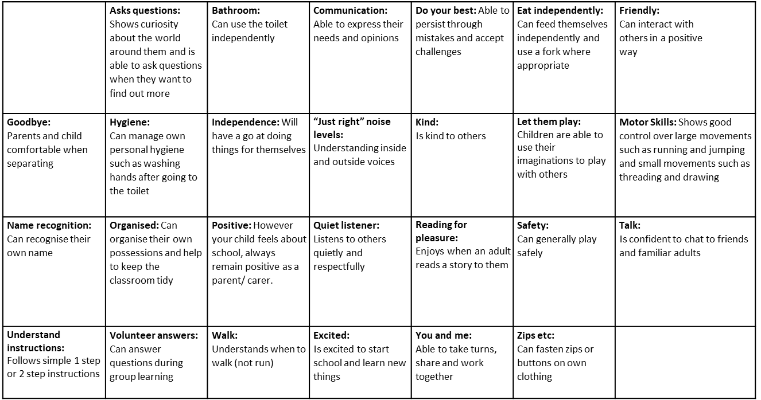


Getting Ready
for Reception
We understand that every child is unique. We don’t expect all children to be able to do these things all of the time, but this does give a good idea of what to work towards with your child before they start school.
This is a useful website for starting discussions and addressing any concerns your child may have.
Embers | For Parents (embersthedragon.co.uk)

Slide 4
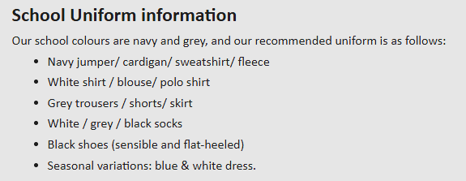
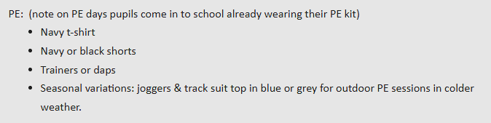
School Uniform
Get Them Ready for School with Our Quality School Uniform, Essentials and Accessories | Shop at Your Local Monkhouse Store | Trusted School Uniform Supplier
Please ensure that you name everything !

Slide 5
Forest School
“There is no such thing as bad weather, just a bad choice of clothes!”
Please make sure that you supply your child with named waterproof clothes and wellies to be kept in school for rainy day activities!

Slide 6
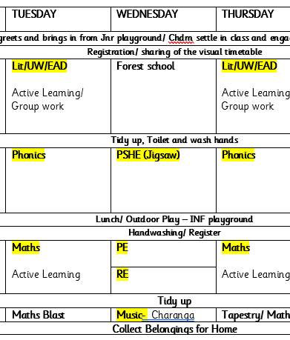
A Day in Reception
Early years foundation stage (EYFS) statutory framework - GOV.UK (www.gov.uk)

