Slide 1

I Love Reading
Book Week 2019

Slide 2
Children need to understand at least 98% of words in a text to comprehend comfortably!

Slide 3
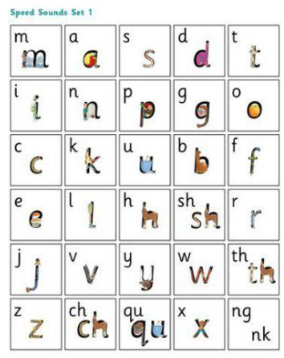
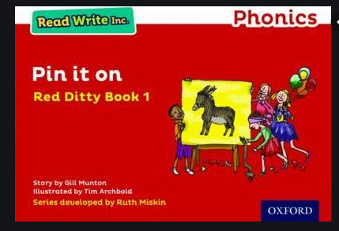
EYFS
When the children are accessing words through phonics they then move onto the RWI books.

Slide 4
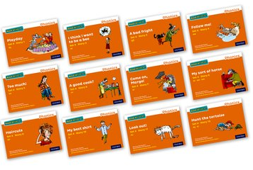
RWI Guided Reading
5 times a week for 20 minutes
Children are taught in groups
Each set of books has 12 books to complete with a mixture of fiction and non fiction texts.
The books relate to sounds they are currently learning in phonics. There is a clear progression therefore children are not faced with digraphs, phonemes and split digraphs they have not seen before.

Slide 5
Taking RWI Guided Reading Books Home
Children are given a paper copy of their guided reading book to bring home to share.
The children will have developed their fluency of reading this book therefore at home you should focus on asking your child questions about the text to further their understanding.
However, we do ask that they are returned on time and in the same condition.

Slide 6
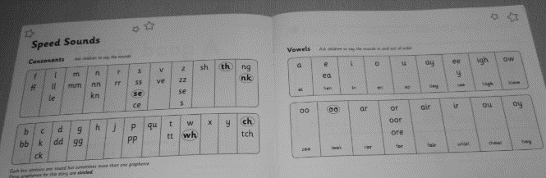
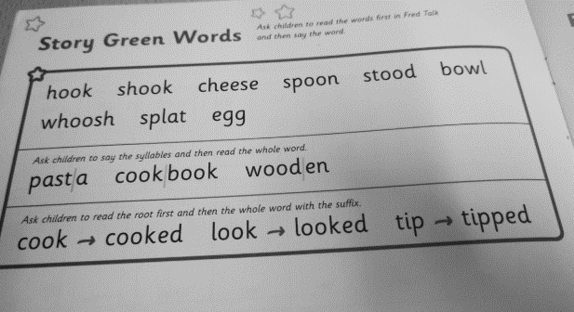
Inside a RWI Guided Reading Book
Start with speed sounds.
Children to say the sound out loud if they struggle with a sound come back to it.
Story green words

Slide 7
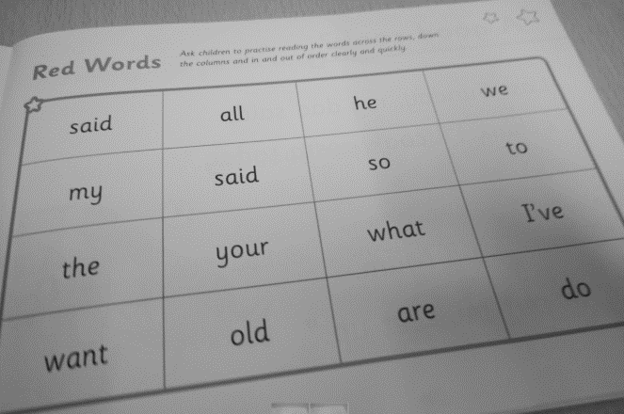
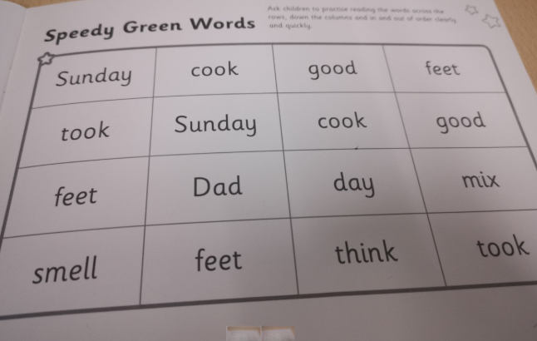
Red words (Tricky words)
Speedy green word - Very last page of the book

Slide 8
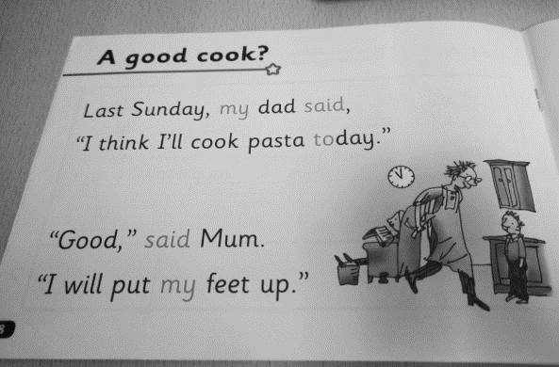
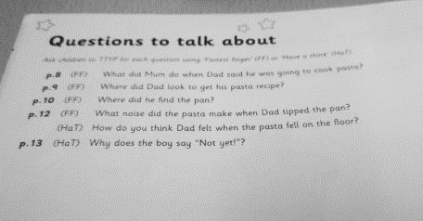
Read through the text
Finally ask questions about the text there are questions printed inside the book usually found on Page 14.

Slide 9
Year 2 - Whole Class Guided Reading
Taught in groups
Over a series of lessons children will focus on an extract or a whole text.
They will develop skills to help progress their comprehension of what they are reading.

Slide 10

Predict
Front cover – title, illustrations
Blurb (Synopsis) – gives a preview of what the text is about.
Children predict what is going to happen next.
Example activity:

Slide 11
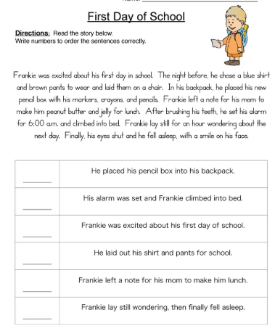
Summarise
Children may be asked to put events into an order verbally, numbering events or using story maps
In non-fiction, this may included summarising paragraphs of the main events which have happened.
In fiction, this could include summarising characters’ traits both internally and externally.

Slide 12
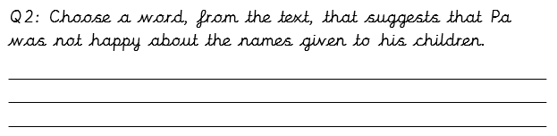
Language
Children may be asked to explain what a word means.
They may also be asked to copy a word / phrase etc which means a certain thing.

Slide 13
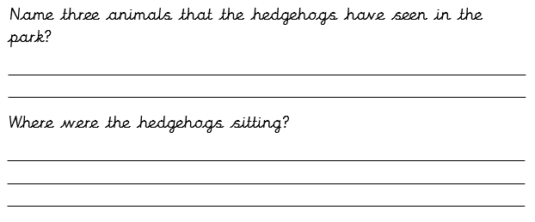

Retrieval and Inference
Retrieval means taking the answer directly from the text.
Inference means reading between the lines – it may be implied implicitly or explicitly by the author.
Inference questions tend to be where children need to give a point and evidence.

Slide 14
Activities
At the back of the hall there are tables set up with a selection of resources we use in Guided Reading at St John’s Mead. Please feel free to use the remaining time of this workshop to look at them.
There are some reading book marks available for you to take home that will provide prompts of how to ask questions.
If you have any further questions please ask ☺

